Slide 1
Covid 19 detection using Machine Learning
Inter Disciplinary Project
Yogeshvar Reddy.K-(Ap20110010145)
Lavanya Parchuri -(AP20110010233)
Sriya Padmanabhuni-(AP20110010274)
Lovely Yeswanth Panchumarthi –(AP20110010299)

Slide 2
Contents
Abstract.
Image Data Pre Processing.
Histogram Distribution.
Histogram of Oriented Gradients.
Machine Learning Algorithm.
Discussion.
Results.

Slide 3
Abstract
This study meticulously analyzes machine learning techniques in the context of COVID-19 detection using chest X-ray images. The dataset, comprising diverse chest X-rays, is subjected to an evaluation of classifiers, including Support Vector Machine (SVM), Random Forest, K-Nearest Neighbors (KNN), Gaussian Naive Bayes, Logistic Regression, AdaBoost, Decision Tree, and Rocchio. Additionally, two distinct feature extraction methods—histogram equalization and histogram of oriented gradients (HOG)—are comprehensively explored. The experimental methodology involves rigorous preprocessing, including resizing and normalization. Each classifier performance is assessed using standard metrics: accuracy, precision, recall, F1-score, and Receiver Operating Characteristic (ROC) curves. The resulting analysis reveals discernible patterns and trends, offering insights into the strengths and limitations of each approach. The findings highlight significant variations in classifier performance, emphasizing the pivotal role of feature extraction methods in shaping overall accuracy. This study contributes significantly to the ongoing discourse on robust diagnostic tool development for COVID-19 by elucidating optimal combinations of machine learning techniques and feature extraction methods for enhanced detection accuracy.

Slide 4
Dataset Overview
Data set – ‘xray_dataset_covid19’ (Source Kaggle).
In prior data set is divided into Test Data of 640 images and Train Data of 5900 images.
It is a two labeled data set namely NORMAL and PNEUMONIA.
Image Processing
As the Data sets are images, we have different sizes and different resolutions for each images.
So first we did “Histogram equalization”.
And “Histogram of Oriented Gradients”.
Means Resizing to (256, 256).

Slide 5
Histogram
The primary goal of histogram equalization is to redistribute the intensity values (pixel values) in an image such that the resulting image has a more uniform or equalized histogram.
This can help reveal details and features in the image that may be otherwise difficult to see due to poor contrast.
Histogram Distribution of Multiple Images
histogram for a set of multiple images and plotting the frequency (number of occurrences) of pixel values across those images.
This can help analyze and compare the distribution of pixel values among the images in the dataset.

Slide 6
Histogram of Oriented Gradients
HOG is a feature descriptor that represents the local distribution of gradient orientations in an image.
The image is divided into small cells, and for each cell, a histogram of gradient orientations is computed based on the gradient values within that cell.
HOG captures information about edges and contours in an image, making it particularly useful for tasks where the shape and structure of objects are important.
HOG is widely used in object detection scenarios, such as pedestrian detection in computer vision applications. It has also been applied in facial recognition, gesture recognition, and other tasks where capturing local gradient information is essential.

Slide 7
Feature Extraction
- Feature extraction is a process of transforming images into numerical data that can be used for machine learning models.
- The code uses the HOG feature descriptor, which extracts features based on the distribution of edge orientations in the image.
- The code performs the following steps for each image:
- Read the image from a path
- Convert the image to grayscale
- Compute the HOG features and the HOG image
- Apply histogram equalization to the HOG image
- Resize the HOG image to 256 x 256 pixels
- Flatten the HOG image to a 1D array
- Append the array to a data list

Slide 8
Feature Extraction
Feature extraction is a process of transforming images into numerical data that can be used for machine learning models.
We uses the histogram equalization technique, which enhances the contrast of images by adjusting the intensity distribution.
We performed the following steps for each image:
Convert the image to grayscale
Apply histogram equalization
Crop the image to a smaller region
Resize the image to 256 x 256 pixels
Flatten the image to a 1D array
Append the array to a data list

Slide 9
SVM
A Support Vector Machine (SVM) is a supervised machine learning algorithm used for classification and regression analysis.
It is particularly well-suited for binary classification tasks, where the goal is to separate data points into one of two classes.
The key idea behind SVM is to find a hyperplane that best separates the data into two classes while maximizing the margin between the classes.
This hyperplane is chosen in such a way that it has the maximum possible distance (margin) from the nearest data points of both classes.
These nearest data points, known as support vectors, play a crucial role in defining the hyperplane.
SVMs can handle linear and non-linear classification problems.

Slide 10
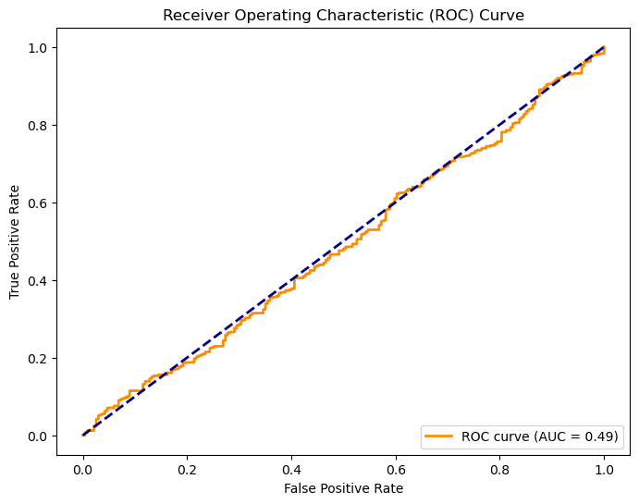
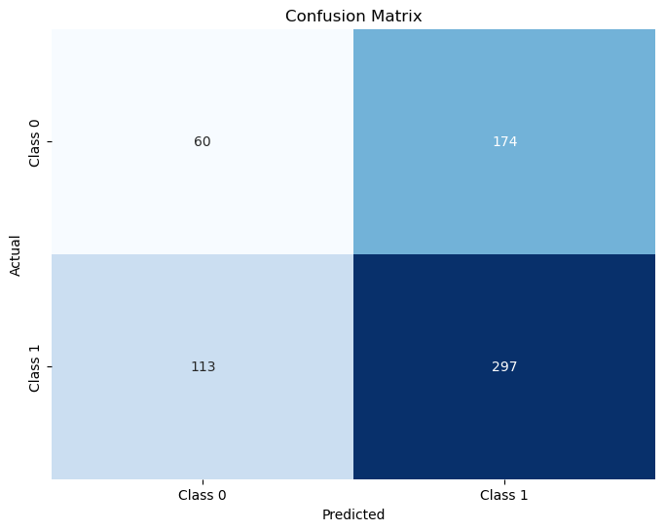
SVM Results with using Histogram equalization
Accuracy: 0.5543478260869565
Precision: 0.630573248407643
Recall: 0.724390243902439
F1-score: 0.674233825198638

Slide 11
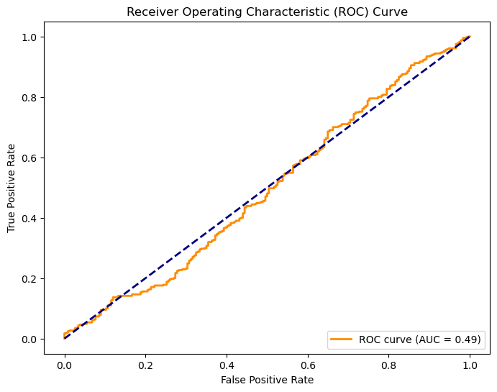
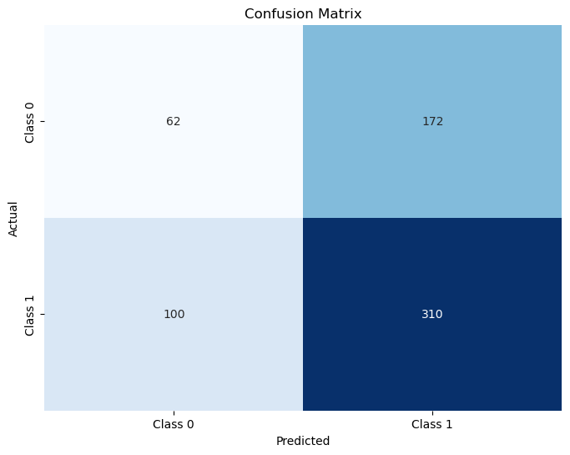
SVM Results with using Histogram of Oriented Gradients
Accuracy: 0.577639751552795 Precision: 0.6431535269709544 Recall: 0.7560975609756098
F1-score: 0.695067264573991

Slide 12
Gaussian Naive Bayes Classifier
Gaussian Naive Bayes is a probabilistic classification algorithm based on Bayes' theorem.
It assumes that features are conditionally independent given the class, and it models the distribution of each feature using Gaussian distributions.
Naive Bayes classifiers are simple, fast, and require a small amount of training data. They often perform well in text classification and other high-dimensional datasets.
The "naive" assumption of feature independence might not hold in all cases, but the model can still perform surprisingly well in practice.

Slide 13
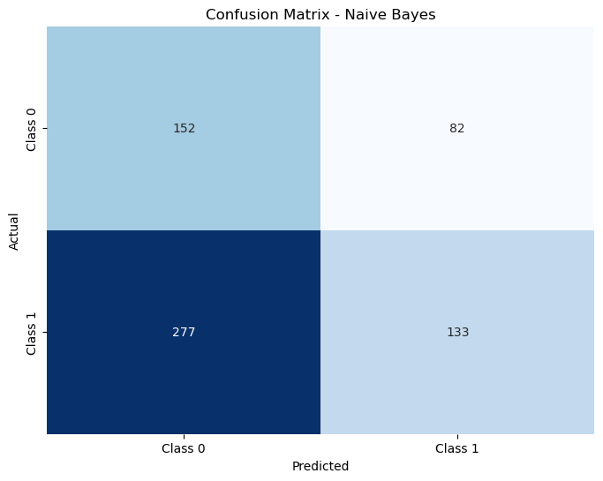
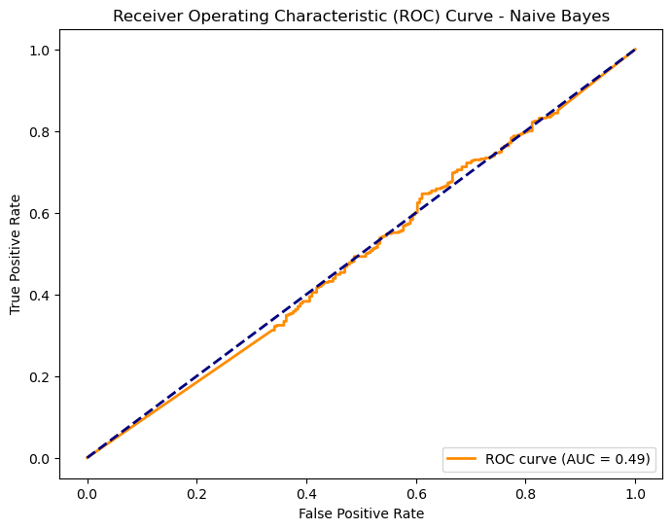
Naïve Bayes Neighbors Results with using Histogram equalization
Accuracy: 0.44254658385093165 Precision: 0.6186046511627907 Recall: 0.32439024390243903 F1-score: 0.4256

Slide 14
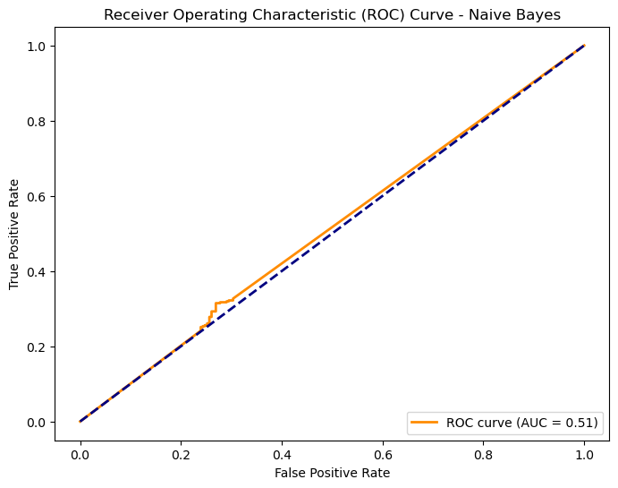
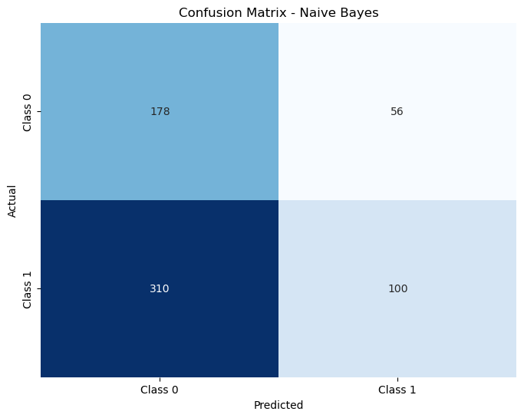
Naïve Bayes Neighbors Results with using Histogram of Oriented Gradients
Accuracy: 0.43167701863354035 Precision: 0.6410256410256411 Recall: 0.24390243902439024
F1-score: 0.35335689045936397

Slide 15
Logistic Regression Classifier
Logistic Regression is a linear model used for binary classification problems, predicting the probability that an instance belongs to a particular class.
Logistic Regression applies the sigmoid activation function to the linear combination of input features, mapping the output to the range [0, 1], interpreted as class probabilities.
Logistic Regression provides coefficients for each feature, allowing for interpretation of the impact of each feature on the predicted probability.
Regularization terms can be added to the logistic regression cost function to prevent overfitting and control the complexity of the model.

Slide 16
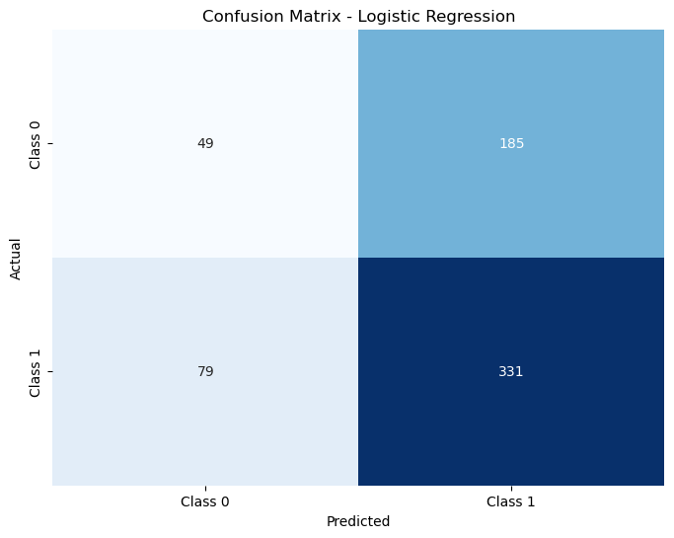
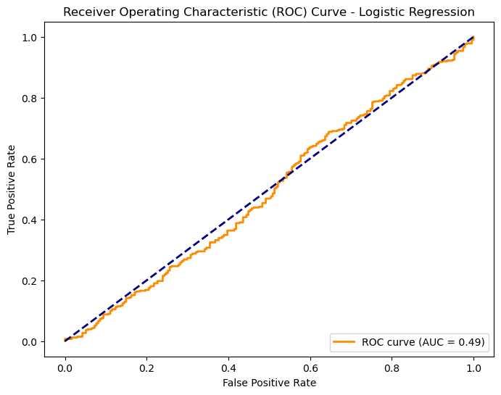
Logistic Regression Neighbors Results with using Histogram equalization
Accuracy: 0.5900621118012422 Precision: 0.6414728682170543 Recall: 0.8073170731707318 F1-score: 0.7149028077753781

Slide 17
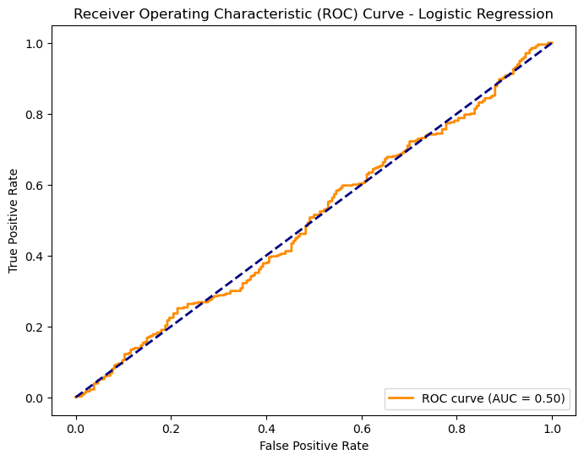
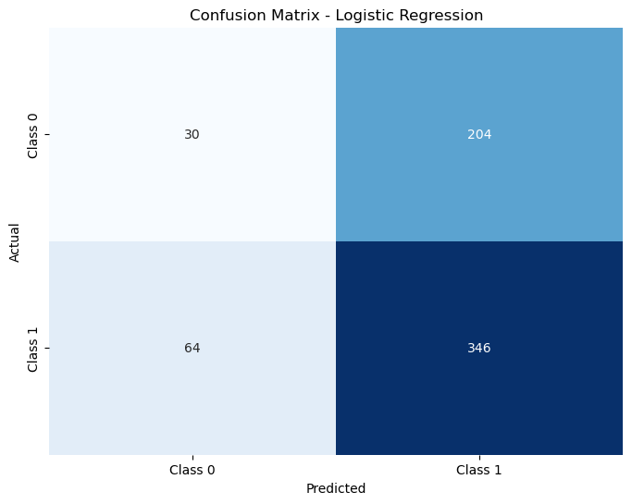
Logistic Regression Neighbors Results with using Histogram of Oriented Gradients
Accuracy: 0.5838509316770186 Precision: 0.6290909090909091 Recall: 0.8439024390243902
F1-score: 0.7208333333333333

Slide 18
Rocchio Classifier
Rocchio classifier is a method of relevance feedback in information retrieval systems that uses the vector space model to represent documents and queries.
Rocchio classifier computes the centroid or the average vector of each class of documents, and then assigns a new document to the class whose centroid is closest to it.
Rocchio classifier is simple and efficient, but it assumes that the classes are spherical and have similar sizes, which may not be true in reality.
Rocchio classifier can be improved by using different weights for the original query, the relevant documents, and the irrelevant documents, and by using different distance measures other than the Euclidean distance.

Slide 19
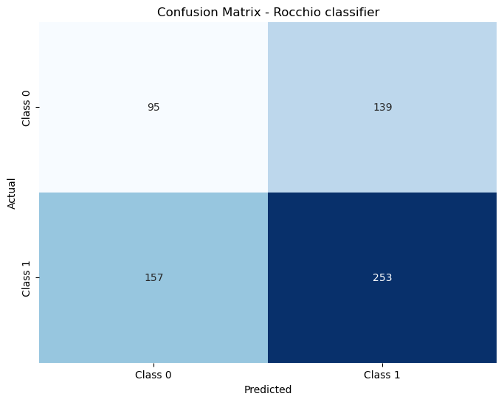

Rocchio Classifier Results with using Histogram equalization

Slide 20
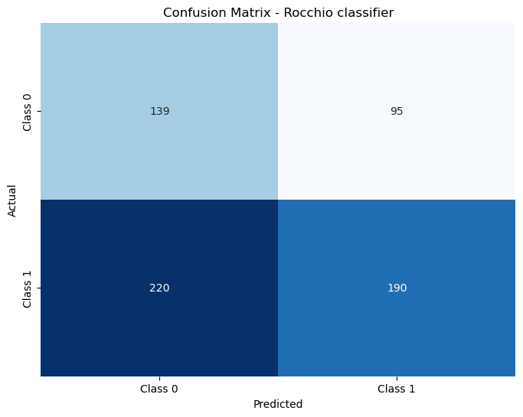
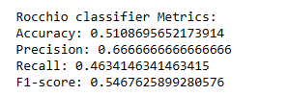
Rocchio Classifier Results with using Histogram of Oriented Gradients

Slide 21
Decision Tree Classifier
A decision tree classifier is a machine learning model that can be used to classify data into different categories based on a set of rules. A decision tree classifier works by splitting the data into smaller subsets based on the values of certain features, until a final prediction is made for each subset. A decision tree classifier can be visualized as a flowchart-like structure, where each node represents a feature, each branch represents a rule, and each leaf represents a prediction. For example, a decision tree classifier can be used to predict whether a person has diabetes or not based on their age, weight, blood pressure, and blood sugar levels.
It is easy to understand and interpret, as it mimics the human decision-making process.
It can handle both numerical and categorical data, and can deal with missing values and outliers.
It can perform well on both linear and non-linear problems, and can capture complex interactions among the features.

Slide 22
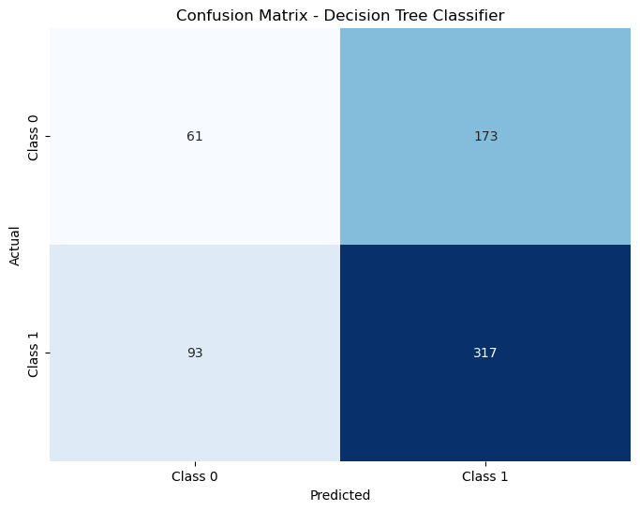
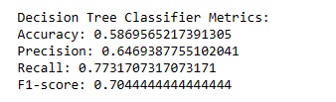
Decision Tree Classifier Results with using Histogram equalization

Slide 23
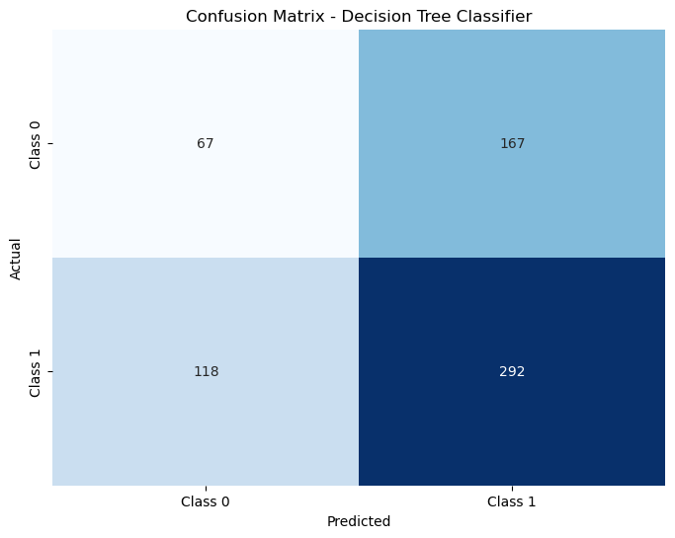
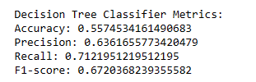
Decision Tree Classifier Results with using Histogram of Oriented Gradients

Slide 24
Random Forest
Random Forest is an ensemble learning method that combines the predictions of multiple decision trees to improve the overall accuracy and robustness of the model.
It builds a multitude of decision trees during training and outputs the mode of the classes for classification problems or the average prediction for regression problems.
Each tree in the Random Forest is constructed using a subset of the training data and a random subset of features.
The randomness helps to decorrelate the trees, making the model less prone to overfitting and more robust.
Random Forest provides a measure of feature importance, which helps in understanding the contribution of each feature to the model's predictions.
Features that frequently appear near the top of the trees are considered more important.

Slide 25
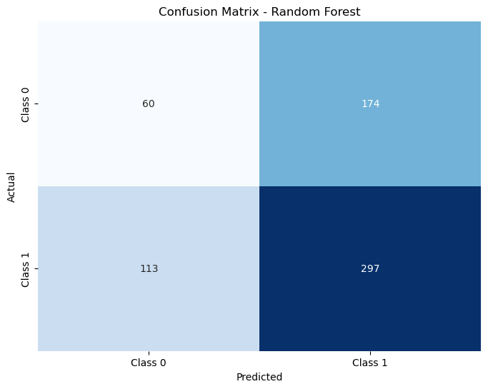
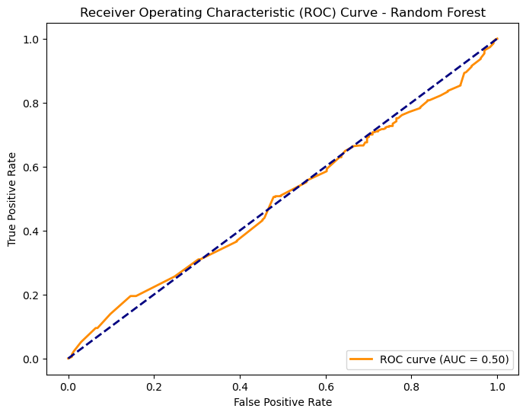
Random forest Results with using Histogram equalization
Accuracy: 0.5543478260869565 Precision: 0.6305732484076433 Recall: 0.724390243902439
F1-score: 0.674233825198638

Slide 26
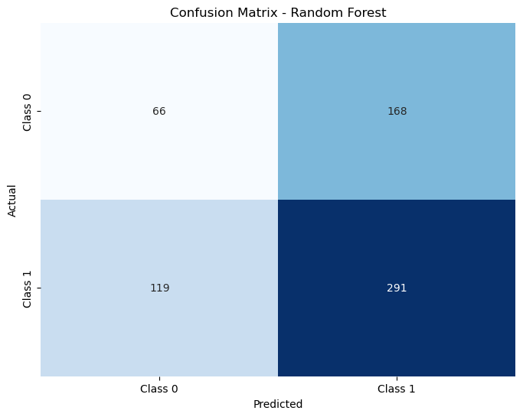
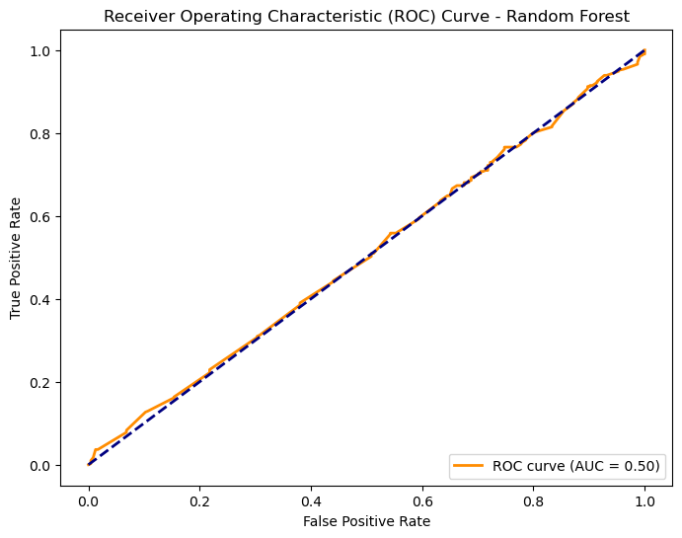
Random forest Results with using Histogram of Oriented Gradients
Accuracy: 0.5543478260869565 Precision: 0.6339869281045751 Recall: 0.7097560975609756
F1-score: 0.669735327963176

Slide 27
KNN Classifier
KNN is an instance-based learning algorithm that classifies new data points based on the majority class of their k-nearest neighbors.
The choice of the value of k influences the model's sensitivity to local patterns.
KNN relies on a distance metric (e.g., Euclidean distance) to measure the similarity between data points.
The algorithm assumes that similar instances in the feature space tend to belong to the same class.
KNN is a non-parametric algorithm, meaning it doesn't make explicit assumptions about the underlying data distribution.

Slide 28
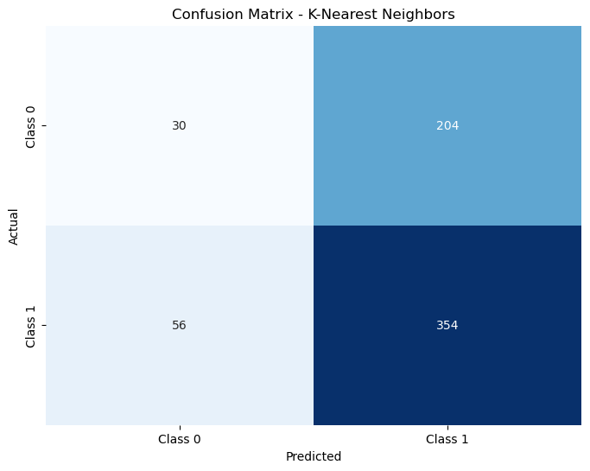
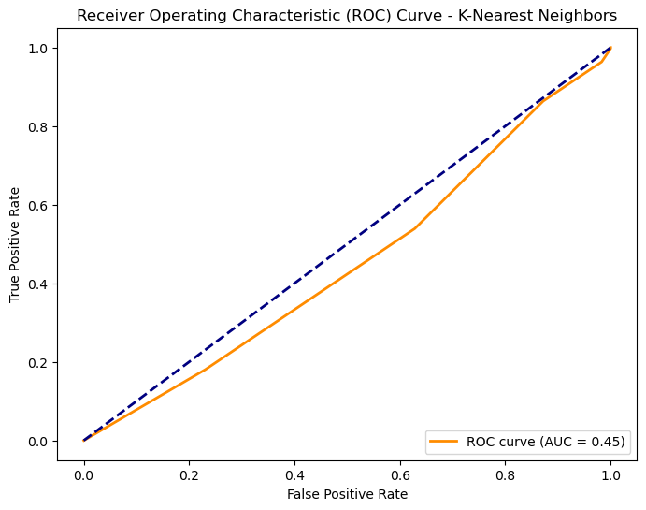
K-Nearest Neighbors Results with using Histogram equalization
Accuracy: 0.5962732919254659 Precision: 0.6344086021505376 Recall: 0.8634146341463415
F1-score: 0.731404958677686

Slide 29

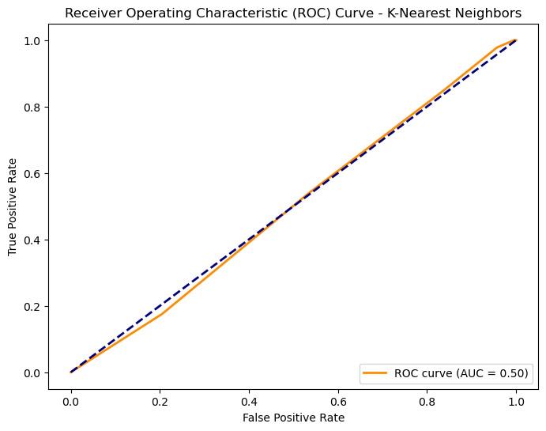
K-Nearest Neighbors Results with using Histogram of Oriented Gradients
Accuracy: 0.5993788819875776 Precision: 0.6397058823529411 Recall: 0.848780487804878
F1-score: 0.7295597484276729

Slide 30
AdaBoostClassifier
AdaBoostClassifier is a machine learning model that uses an ensemble of weak classifiers to create a strong classifier. A weak classifier is a model that can perform slightly better than random guessing, while a strong classifier is a model that can achieve high accuracy and low error.
AdaBoostClassifier works by iteratively training the weak classifiers on the data, and adjusting the weights of the data points based on the performance of the previous classifiers. The final prediction is made by combining the predictions of the weak classifiers using a weighted majority vote. AdaBoostClassifier is a popular and effective method for classification problems, as it can handle both numerical and categorical data, and can deal with imbalanced and noisy data. However, AdaBoostClassifier can also be sensitive to outliers and overfitting, and can be computationally expensive.

Slide 31
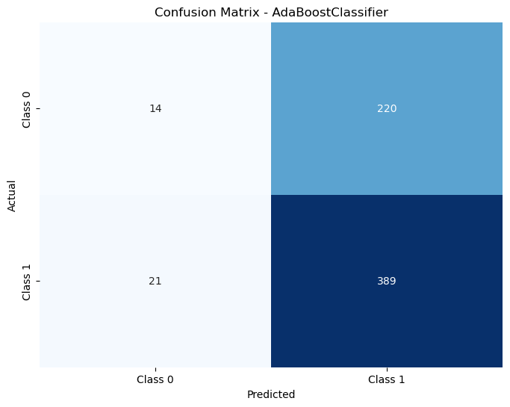

AdaBoostClassifier Results with using Histogram equalization

Slide 32

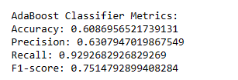
AdaBoostClassifier Results with using Histogram of Oriented Gradients

Slide 33
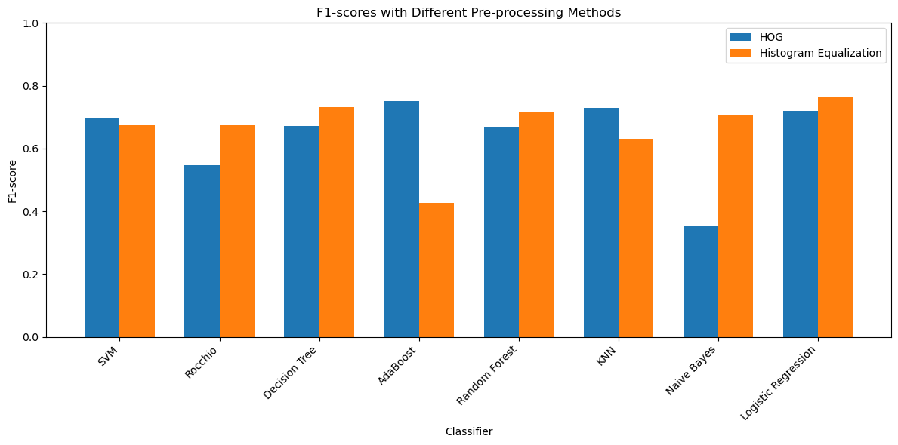
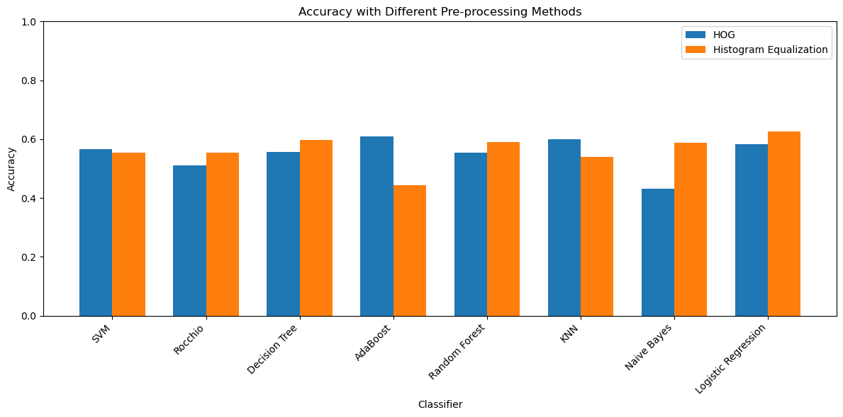
Results

Slide 34
Conclusion
Histogram Equalization:
Moderate Performance: Histogram Equalization yielded moderate performance across classifiers, with SVM, Random Forest, and others achieving comparable accuracies around 55.4%. This suggests that the method alone may not be sufficient for achieving high sensitivity in COVID-19 detection.
KNN Superiority: Notably, KNN outperformed other classifiers, attaining an accuracy of 59.6% and showcasing enhanced sensitivity (recall of 86.3%). This highlights the potential of Histogram Equalization in combination with KNN for improved COVID-19 identification.

Slide 35
Conclusion
Histogram of Oriented Gradients (HOG):
Enhanced Sensitivity: The incorporation of HOG preprocessing significantly improved sensitivity in several classifiers, notably SVM and AdaBoost, showcasing the potential of this technique for COVID-19 detection.
AdaBoost Excellence: AdaBoost, with HOG, emerged as the top-performing model, achieving an accuracy of 60.9% and an exceptional recall of 92.9%. This indicates that the synergistic effect of boosting techniques with HOG features enhances the model's ability to identify COVID-19 cases effectively.
KNN Dominance: KNN, coupled with HOG, continued to demonstrate superiority with an accuracy of 59.9%, precision of 64.0%, and a notable recall of 84.9%. This reinforces the effectiveness of KNN in leveraging HOG features for improved sensitivity.

Slide 36
Future Works
We should try different possibilities of the pixels values.
Happen to try the possibilities to try different preprocessing methods.
Like binary data , histogram data, gray scale inputs.
Also should try with different ML or DL methods.

Slide 37
References
Apostolopoulos, I. D., & Mpesiana, T. A. (2021). "Covid-19: automatic detection from X-ray images employing transfer learning with machine learning algorithms," Informatics in Medicine Unlocked, 20, 100429.
Pereira, R. M., Bertolini, D., Teixeira, L. O. B. M., Silla, C. N., & Costa, Y. M. G. (2020). "COVID-19 identification in chest X-ray images on flat and hierarchical classification scenarios," Computers, Materials & Continua, 63(2), 537-551.
Elaziz, M. A., Hosny, K. M., Salah, A., Darwish, M. M., & Lu, S. (2020). "New machine learning algorithm for image-based diagnosis of COVID-19," PloS one, 15(6), e0235187.
Albahli, S., Abualsaud, K., Alshammari, R., Alshammari, F., & Alwabil, A. (2021). "Machine learning-based approach for predicting the prognosis of COVID-19 patients," Computers, Materials & Continua, 66(3), 2933-2947.

